Slide 1
Direct marketing
Report

Slide 2
Agenda
Introduction
About data
charts
recommendation

Slide 3


Introduction
The data set includes data from a direct marketer who sells his products only via direct mail. He sends catalogs with product characteristics to customers who then order directly from the catalogs. The marketer has developed customer records to learn what makes some customers spend more than others.

Slide 4
About data
information

Slide 5
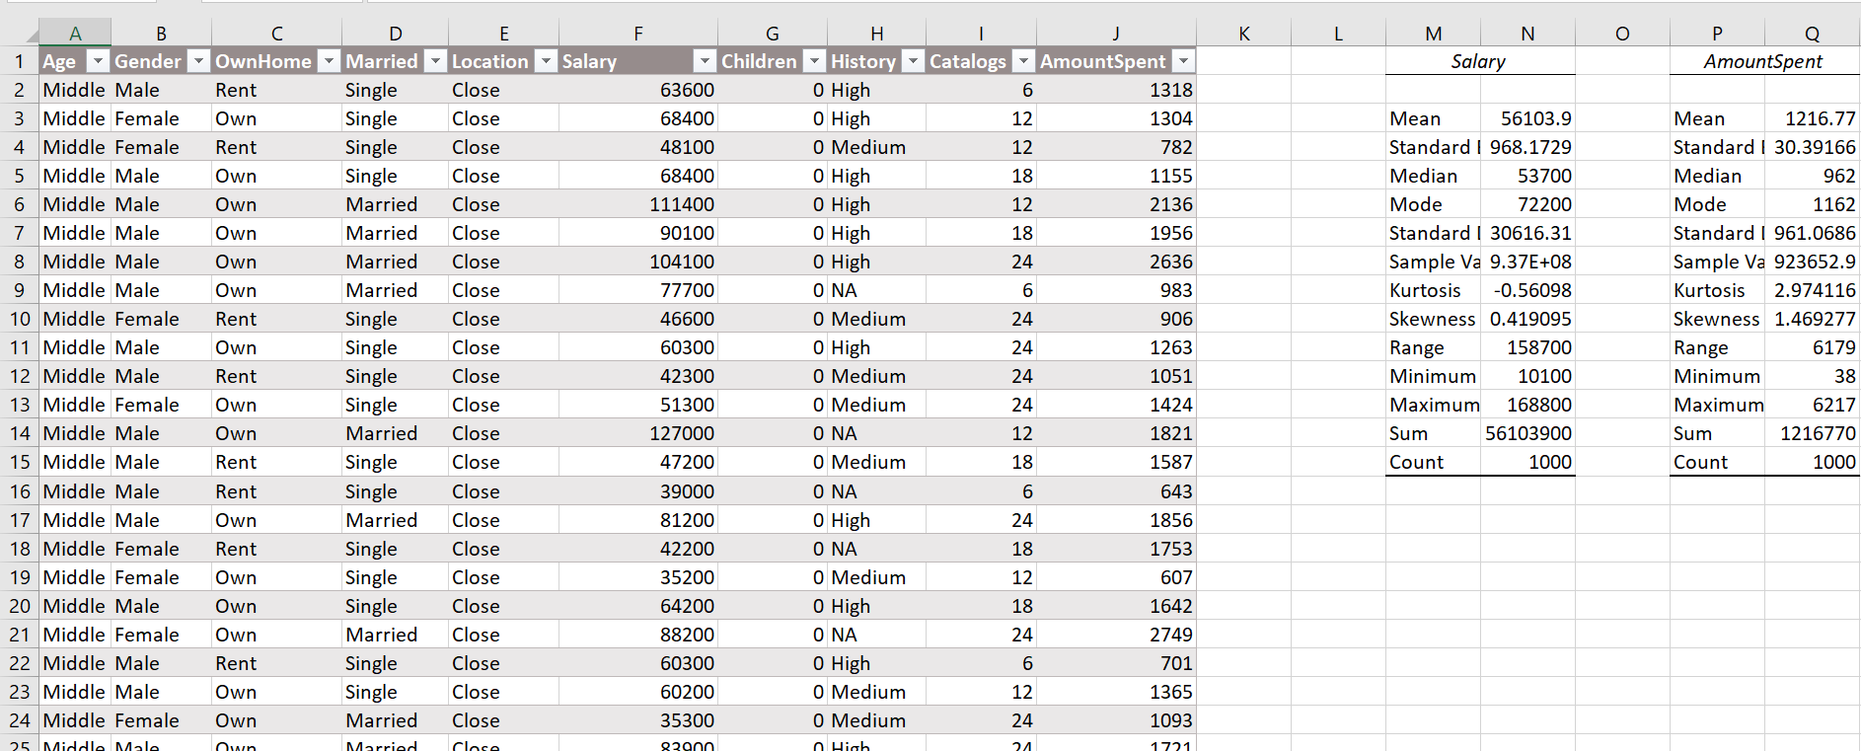
About data

Slide 6
Table
The data set includes n = 1000 customers
the following variables: Age (of customer; old/middle/young); Gender (male/female); OwnHome (whether customer owns home; yes/no); Married (single/married); Location (far/close; in terms of distance to the nearest brick and mortar store that sells similar products); Salary (yearly salary of customer; in dollars); Children (number of children; 0–3); History (of previous purchase volume; low/medium/high/NA; NA means that this customer has not yet purchased); Catalogs (number of catalogs sent); and AmountSpent (in dollars). The objective is to explain AmountSpent in terms of the provided customer characteristics

Slide 7
Dashboard&charts
Direct marketing

Slide 8
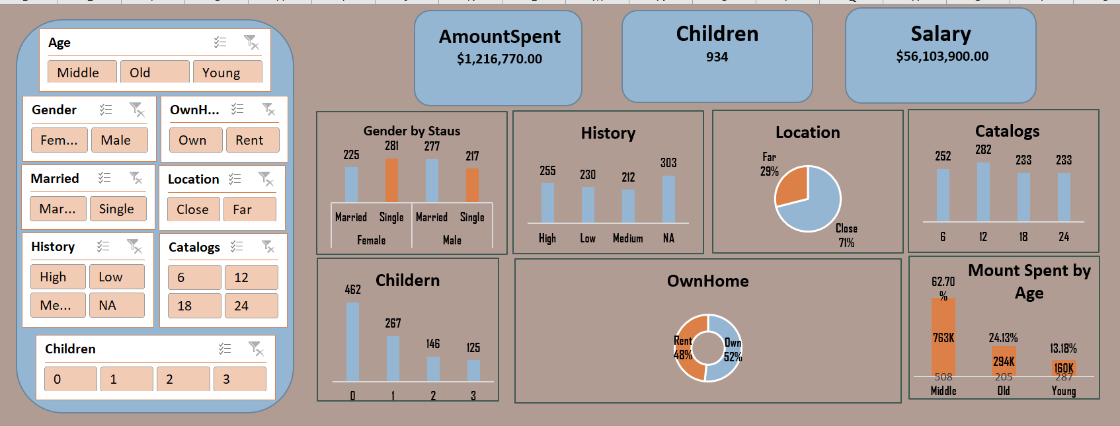
Dashboard

Slide 9
charts
The customer who buy much from the marketer are single female and married male
There are here much customer does not buy from the marketer
The customer who buy from the marketer is living near him

Slide 10
charts
the biggest number of catalogs sent is 12
Most of customers here do not have friends
Customers who owe home are much than who rent
Middle age is buying more than old and young

Slide 11
recommendations
We need to make offers to married female and single male or send them catalogs
1
We can provide home shipping for who is not living near home
2
We can decrease the pages in catalogs
3
We need to provide more products to families who have children
4
We need to provide installment selling to customers who do not owe home
5

Slide 12
Thank you

